Slide 1
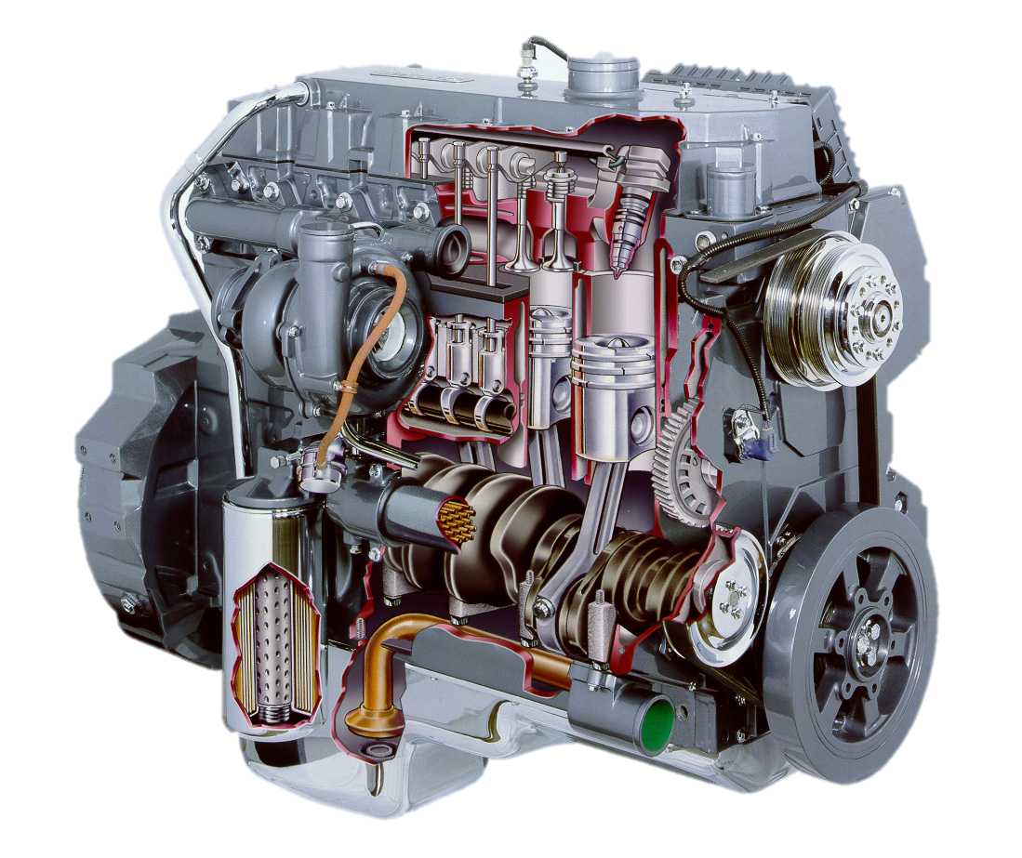
Engine Dimensions AEN/TSM 220

Slide 2
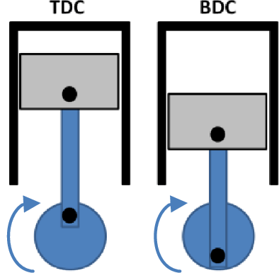
Engine Dimensions

Slide 3
Example: Find the displacement of a 2-cylinder engine that has a bore of 3.54 in. and a stroke of 2.6 in.
Example: How long is the stroke of a single cylinder engine that has a displacement of 165 cc and a piston diameter of 68 mm?

Slide 4
Compression Ratio

Slide 5
Example: Find the compression ratio in an engine that has a displacement of 12 ci and a clearance volume of 0.8 ci.

