Slide 1
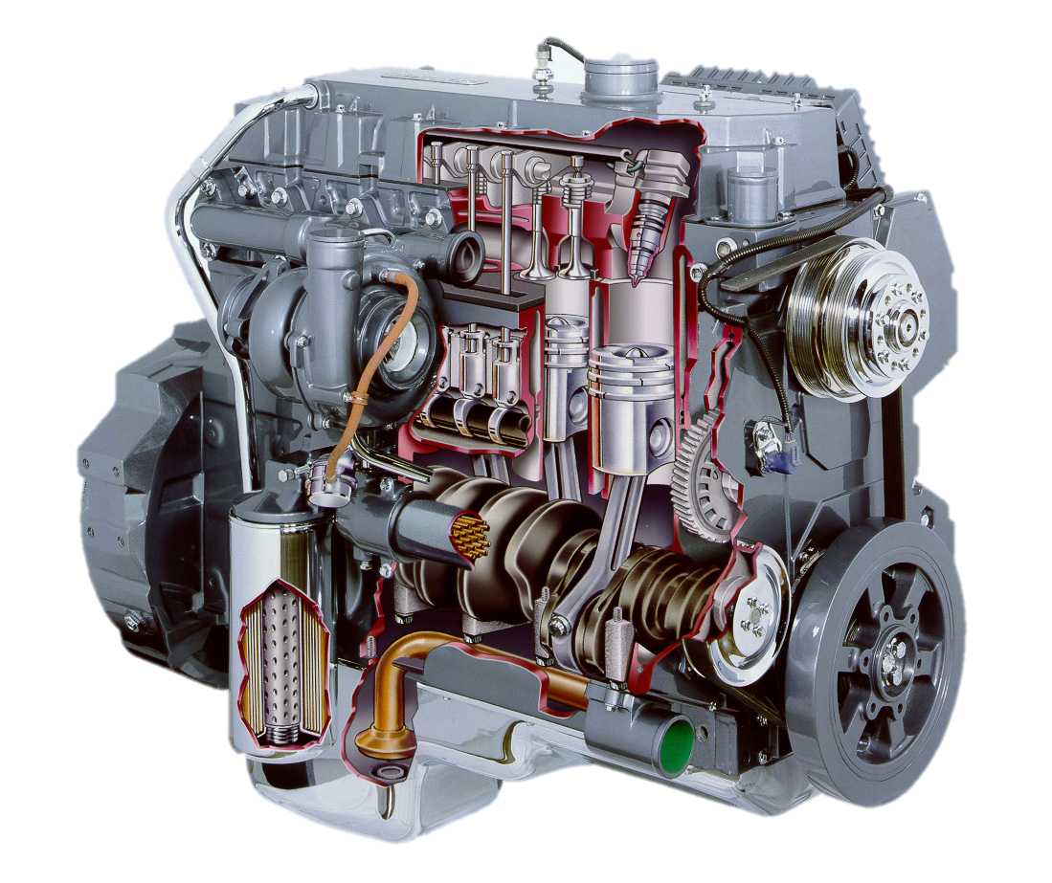
Fuel Properties AEN/TSM 220
Properties
Estimating Performance
Ignition Properties – Octane/Cetane
Engine Efficiency

Slide 2
Fuel Properties
Energy content – BTU or kJ
Energy density – energy/vol OR energy/mass
Physical density – mass/vol
Ignition Properties – Octane/Cetane
Flowability (viscosity)

Slide 3
Energy Density
Calorie: heat required to raise the temperature of one gram of water one degree Celsius.
Joule:
BTU: heat required to raise the temperature of one pound of water one degree Fahrenheit.
Energy density:

Slide 4
Typical SI Fuels
 | Gasoline | E85 | Ethanol
Energy Density (BTU/gal) | 115000 (32000 kJ/L) | 82000 (22900 kJ/L) | 76000 (21200 kJ/L)
Density (lb/gal) | 6.1 | 6.4 | 6.5
Octane | 87 – 95 | 105 | 117
Blends up to 10% for oxygenator (MTBE replacement)
E85 supply availability

Slide 5
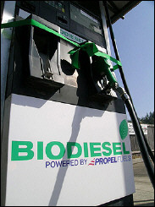
CI Fuels
 | No. 2 Diesel | Pure Biodiesel
Energy density (BTU/gal) | 129,000 (36000 kJ/L) | 118,000 (32900 kJ/L)
Physical density (lb/gal) | 7.08 | 7.33
Cloud point (F) | 5 - 41 | 27 - 54
Cetane | 40 - 55 | 48 - 65
Typical blends are B5 or less
Need additives for cold weather
Biodiesel adds lubricity (Replaces Sulphur)

Slide 6
Fuel Properties AEN/TSM 220
Properties
Estimating Performance
Ignition Properties – Octane/Cetane
Engine Efficiency

Slide 7
Estimating Performance Differences
$$\frac{P_{1}}{P_{2}}=\frac{E_{1}}{E_{2}}$$
A tractor gives a maximum power of 75 hp using petroleum diesel fuel. Approximately how much power would it produce if we used pure biodiesel?

Slide 8
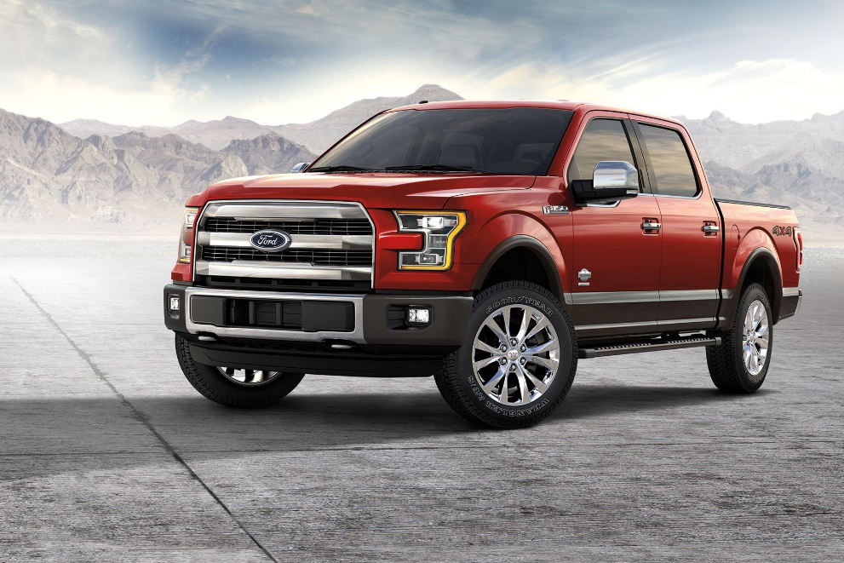
Fuel Economy
2017 Ford F-150 www.fueleconomy.gov
 | E85 | Gasoline
MPG (city) | 13 | 18
MPG (highway) | 18 | 24

Slide 9
Fuel Properties AEN/TSM 220
Properties
Estimating Performance
Ignition Properties – Octane/Cetane
Engine Efficiency

Slide 10
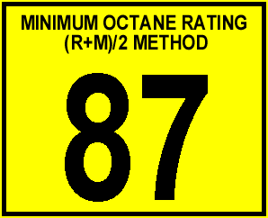
Octane/Cetane
Quantifies autoignition properties of fuel
Octane (Gasoline/Ethanol)
Higher octane = higher ignition pressure
Cetane (Diesel)
Higher cetane = lower ignition pressure

Slide 11
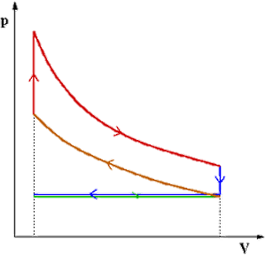
Octane/Cetane Implications
Not related to energy content!
Higher Octane means:
Higher autoignition pressure
Higher compression ratio possible
Less knock and “dieseling”
Cleaner burn
Higher Cetane means:
Lower autoignition pressure
Less low RPM knock
Better cold starting
Maybe higher emissions????

Slide 12
Fuel Properties AEN/TSM 220
Properties
Estimating Performance
Ignition Properties – Octane/Cetane
Engine Efficiency

Slide 13
Efficiency
$$η=\frac{Output}{Input}=\frac{P_{out}}{P_{fuel}}$$
$$P_{fuel}=E∗Q$$
Ex: John Deere 6220 tractor uses 4.85 gal/hr of diesel fuel while producing 75.8 hp. Find the efficiency.

Slide 14
Ex: CaseIH Maxxum 125 uses 26.37 L/hr while producing 85.6 kW of power. Find the efficiency.

