Slide 1
CE 120 Introduction to Civil Engineering
Geotechnical Engineering
L. Sebastian Bryson
University of Kentucky

Slide 2
Introduction to Geotechnical Engineering
All Civil Engineering begins with Geotechnical Engineering
ground

Slide 3
Definitions
Soil mechanics is a discipline that applies the principles of engineering mechanics to soils to predict the mechanical behavior of soil.
Geotechnical Engineering is the branch of civil engineering that deals with soil, rock, and underground water, and their relation to the design construction and operation of engineering projects (Coduto 1998)

Slide 4
Typical Geotechnical Project
Geo-Laboratory ~ for testing
soil properties
Design Office ~ for design & analysis
soil samples
design details
construction site

Slide 5
Geotechnical Applications

Slide 6
Shallow Foundations
~ for transferring building loads to underlying ground
~ mostly for firm soils or light loads
firm ground
bed rock

Slide 7
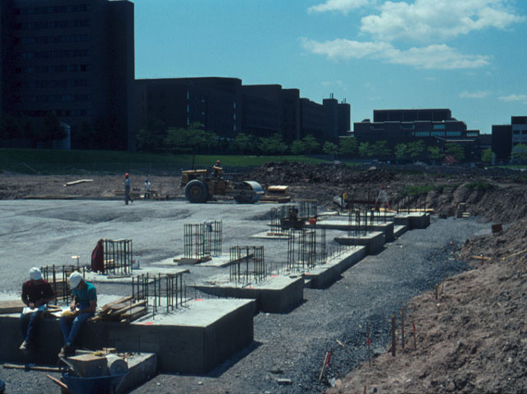
Shallow Foundations

Slide 8
Deep Foundations
~ for transferring building loads to underlying ground
P
I
L
E
~ mostly for weak soils or heavy loads
weak soil
bed rock

Slide 9
Foundation Systems
Deep Foundation Systems: Driven Piles

Slide 10
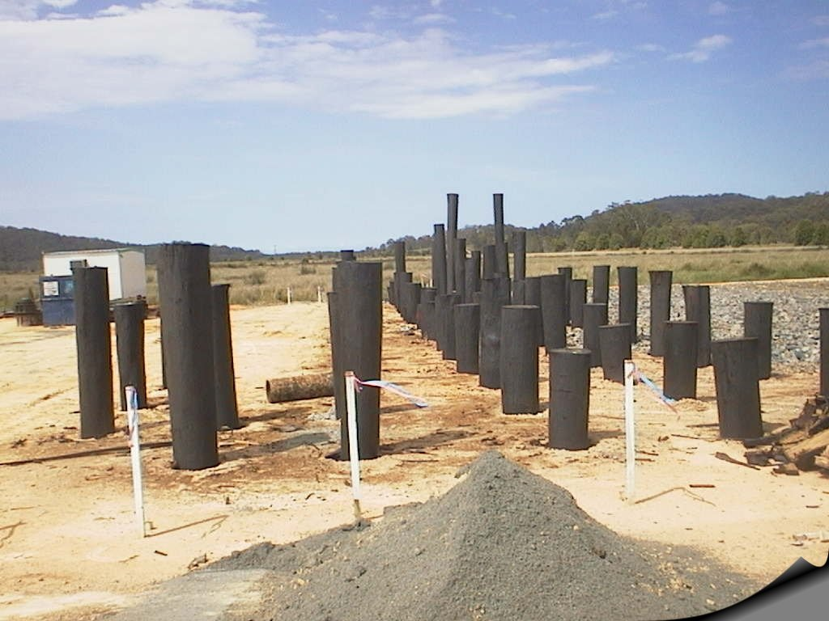
Deep Foundations
Driven timber piles, Pacific Highway

Slide 11
Foundation Systems
Deep Foundation Systems: Drilled Shafts

Slide 12
Retaining Walls
~ Prevent soils from from spreading laterally
retaining wall
Road
Train

Slide 13
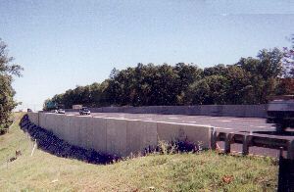
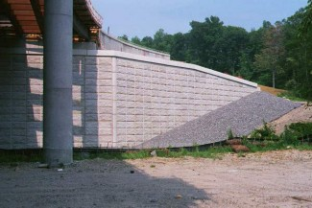
Earth Pressure and Retaining Walls
Reinforced Earth Walls
(The Reinforced Wall Company 2003)

Slide 14
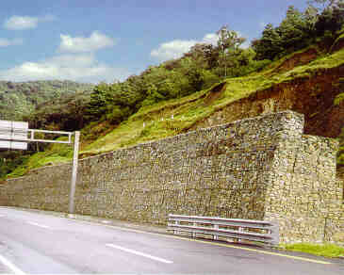
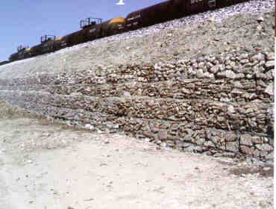
Retaining Structure Systems
Gavions
(Gaviones LEMAC (2003)

Slide 15
Retaining Structure Systems
Tie-backs
(Boulanger and Duncan 2003)

Slide 16
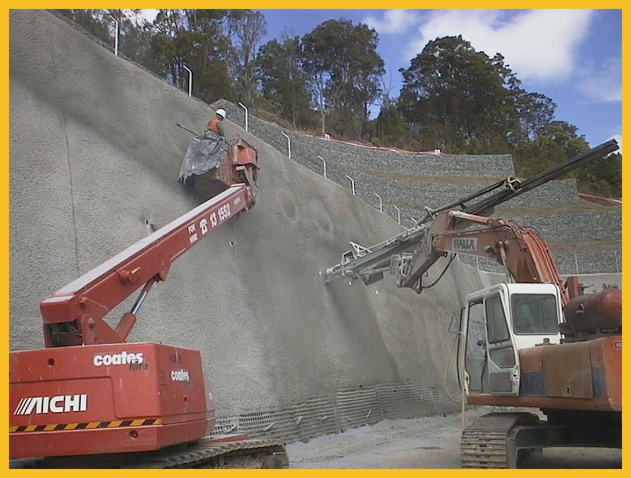
Soil Nailing: steel rods placed into holes drilled into the walls and grouted
Retaining Structure Systems

Slide 17
Retaining Structure Systems
Excavation Support Systems

Slide 18
Sheet Piles
~ sheets of interlocking steel or timber driven into the ground, forming a continuous sheet
warehouse
ship
sheet pile

Slide 19
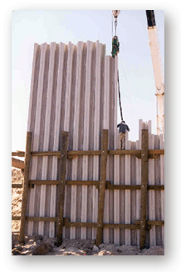
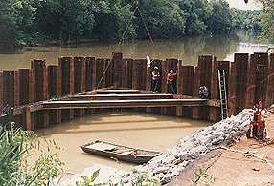
Sheet Piles
~ resist lateral earth pressures
~ used in temporary works
~ used in excavations, waterfront structures

Slide 20
Sheet Pile Walls
(Boulanger and Duncan 2003)

Slide 21
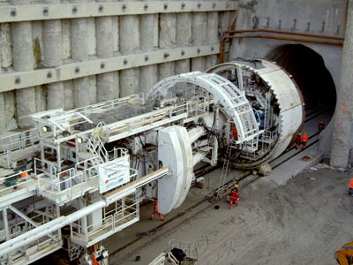
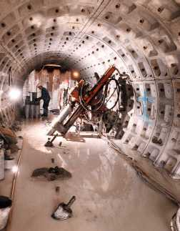
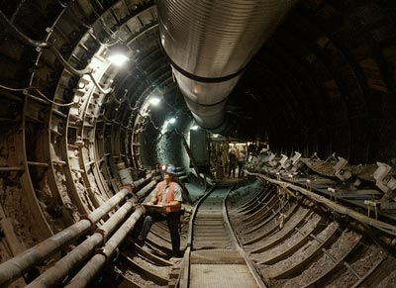
Tunneling

Slide 22
Earth Dams
~ for impounding water
reservoir
clay core
shell
soil

Slide 23
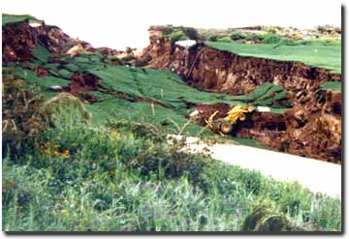
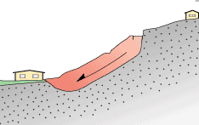
Landslides

Slide 24
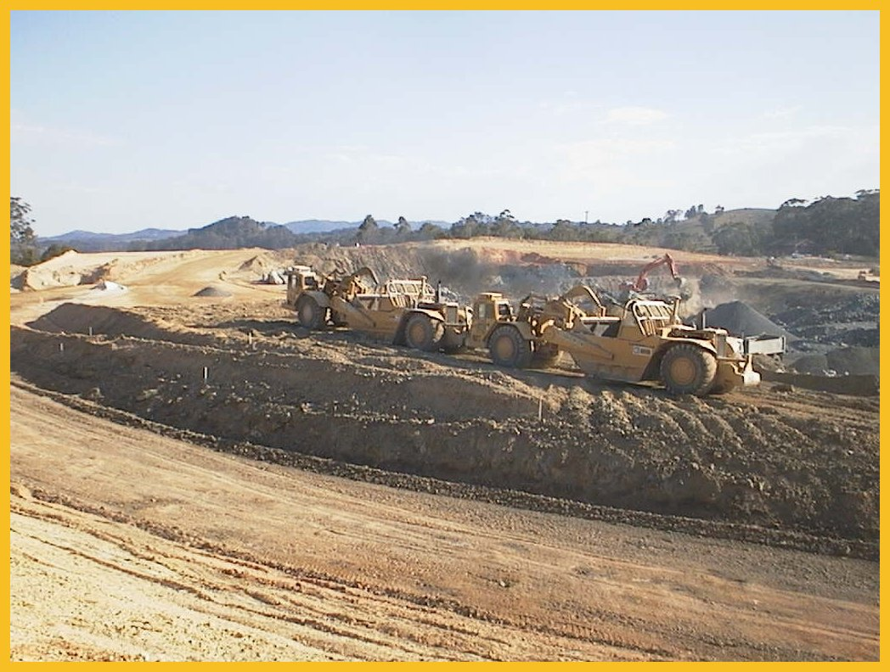
Earthworks
~ preparing the ground prior to construction
Roadwork, Pacific Highway

Slide 25
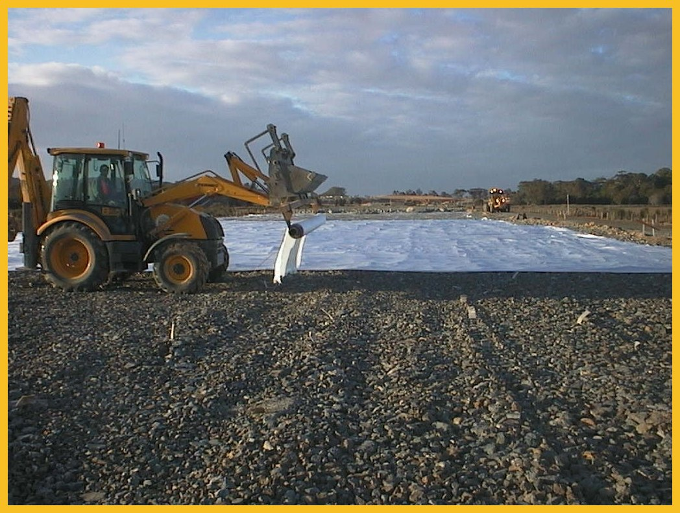
Geofabrics
~ used for reinforcement, separation, filtration and drainage in roads, retaining walls, embankments…
Geofabrics used on Pacific Highway

Slide 26
Geosynthetics
Geosynthetic stabilized walls
(kshitija.wordpress.com 2007)
(Environmental Science & Engineering 2007)

Slide 27
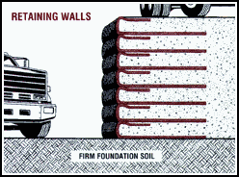
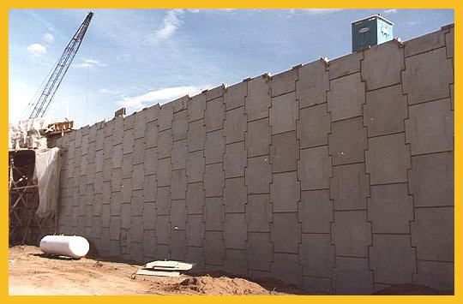
Mechanically Stabilized Earth Walls
~ using geofabrics to strengthen the soil

Slide 28
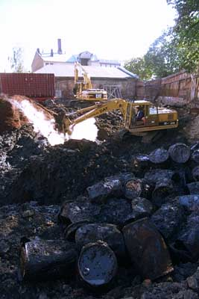
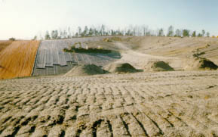
Geoenvironmental Engineering
Characterization and remediation of Geo-environmental hazards
MSW Landfill
(from Willmer 2001)
(from Norwegian Geotechnical Institute 2001)

Slide 29
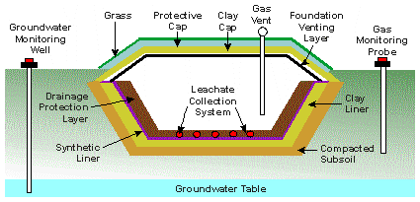
Geoenvironmental Engineering
Waste Disposal in Landfills

Slide 30
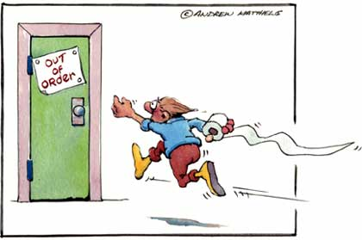
Thou shall not wait till the last minute to involve Geotechnical Engineers.

Slide 31
Geotechnical Engineers – Work Hard, Play Hard!

