Slide 1
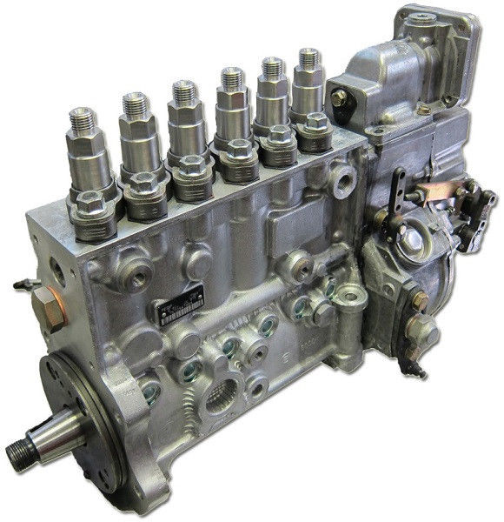
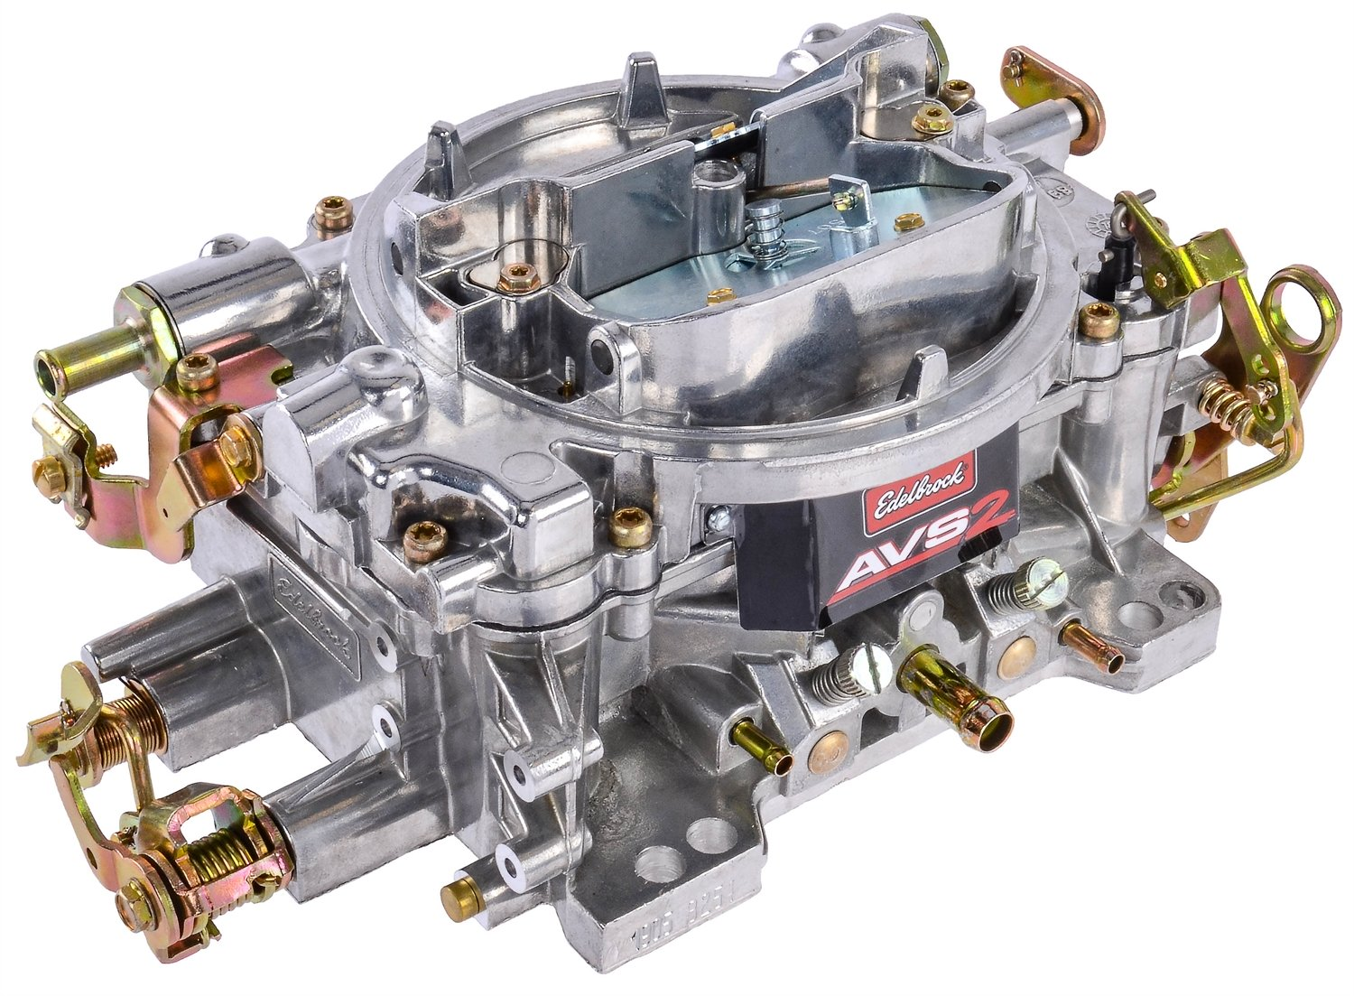
Fuel Delivery Systems
AEN/TSM 220

Slide 2
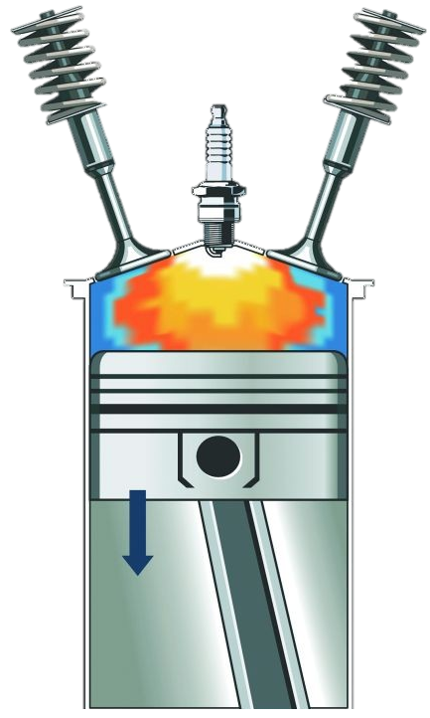
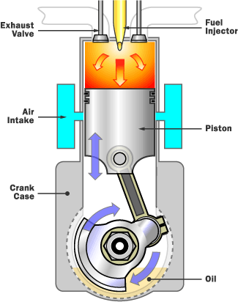
The Goals
Right amount of fuel
Fuel is atomized
Fuel is mixed with air

Slide 3
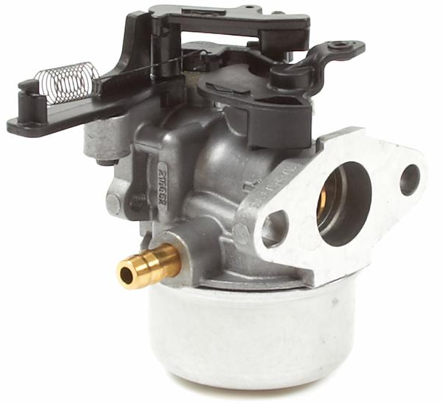
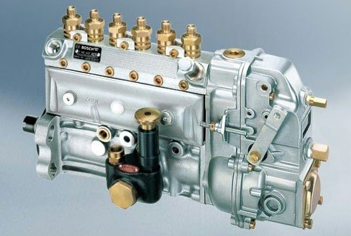
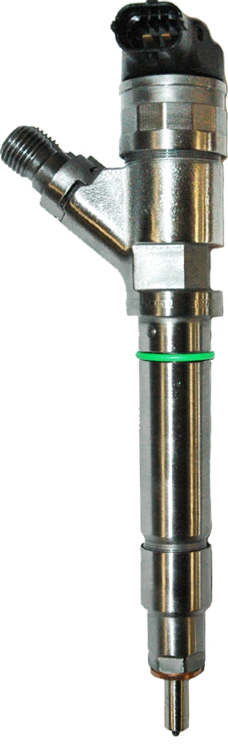
Methods
Spark Ignition
  Fuel introduced before cylinder
  Carburetors
  Also fuel injection
Compression Ignition
  Fuel introduced into cylinder
  Injection pumps

Slide 4
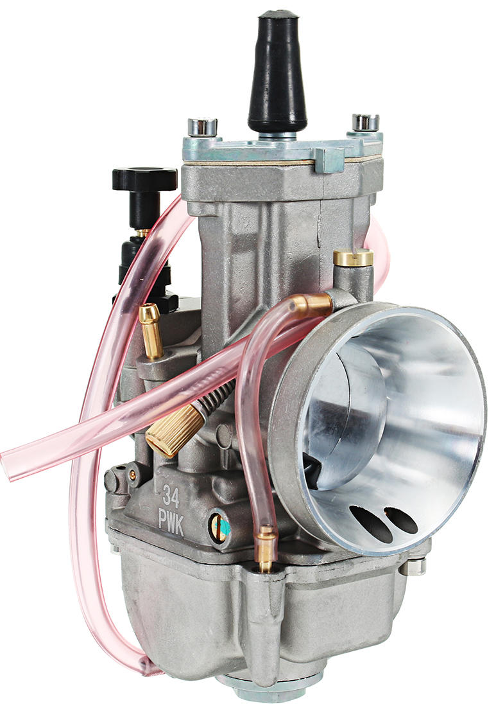
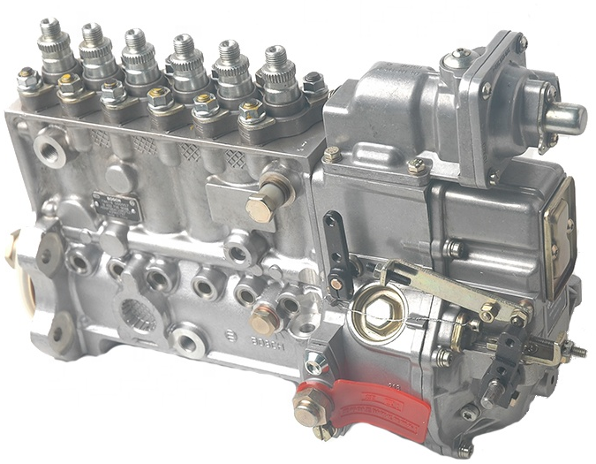
Road Map
Spark Ignition
  Carburetor principles
  Carburetor features and options
  Fuel Injection
Compression Ignition
  Fuel Injection
Modern Engine Control

Slide 5
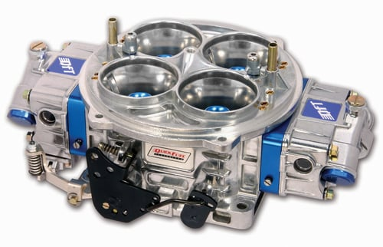
Carburetors
Scientific Principles
Additional Features

Slide 6
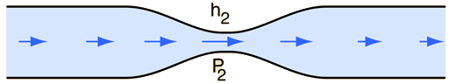

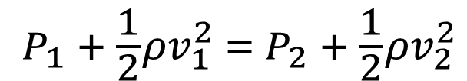
Scientific Principles
$$Q=Av$$
Flow Continuity
Bernoulli
$$P_{1} + \frac{1}{2}ρv_{1}^{2} ={ P}_{2} + \frac{1}{2}ρv_{2}^{2}$$

Slide 8
Carburetors
Scientific Principles
Additional Features

Slide 10
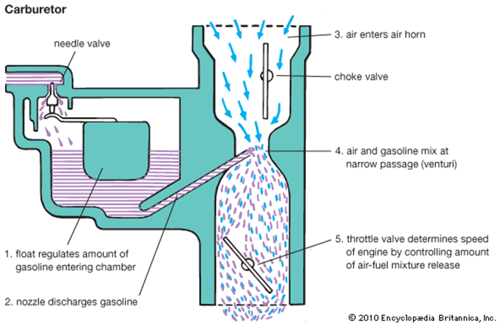
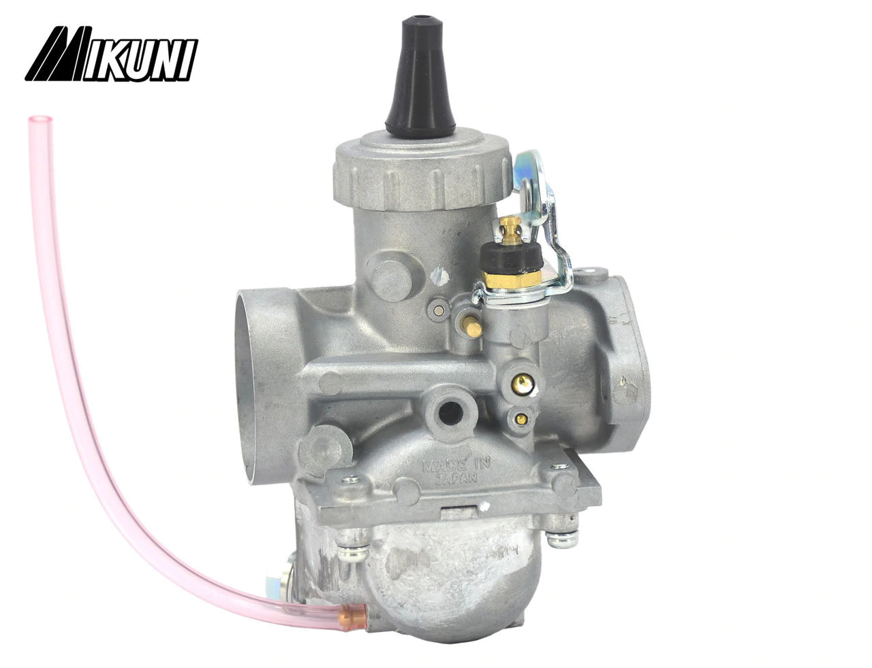
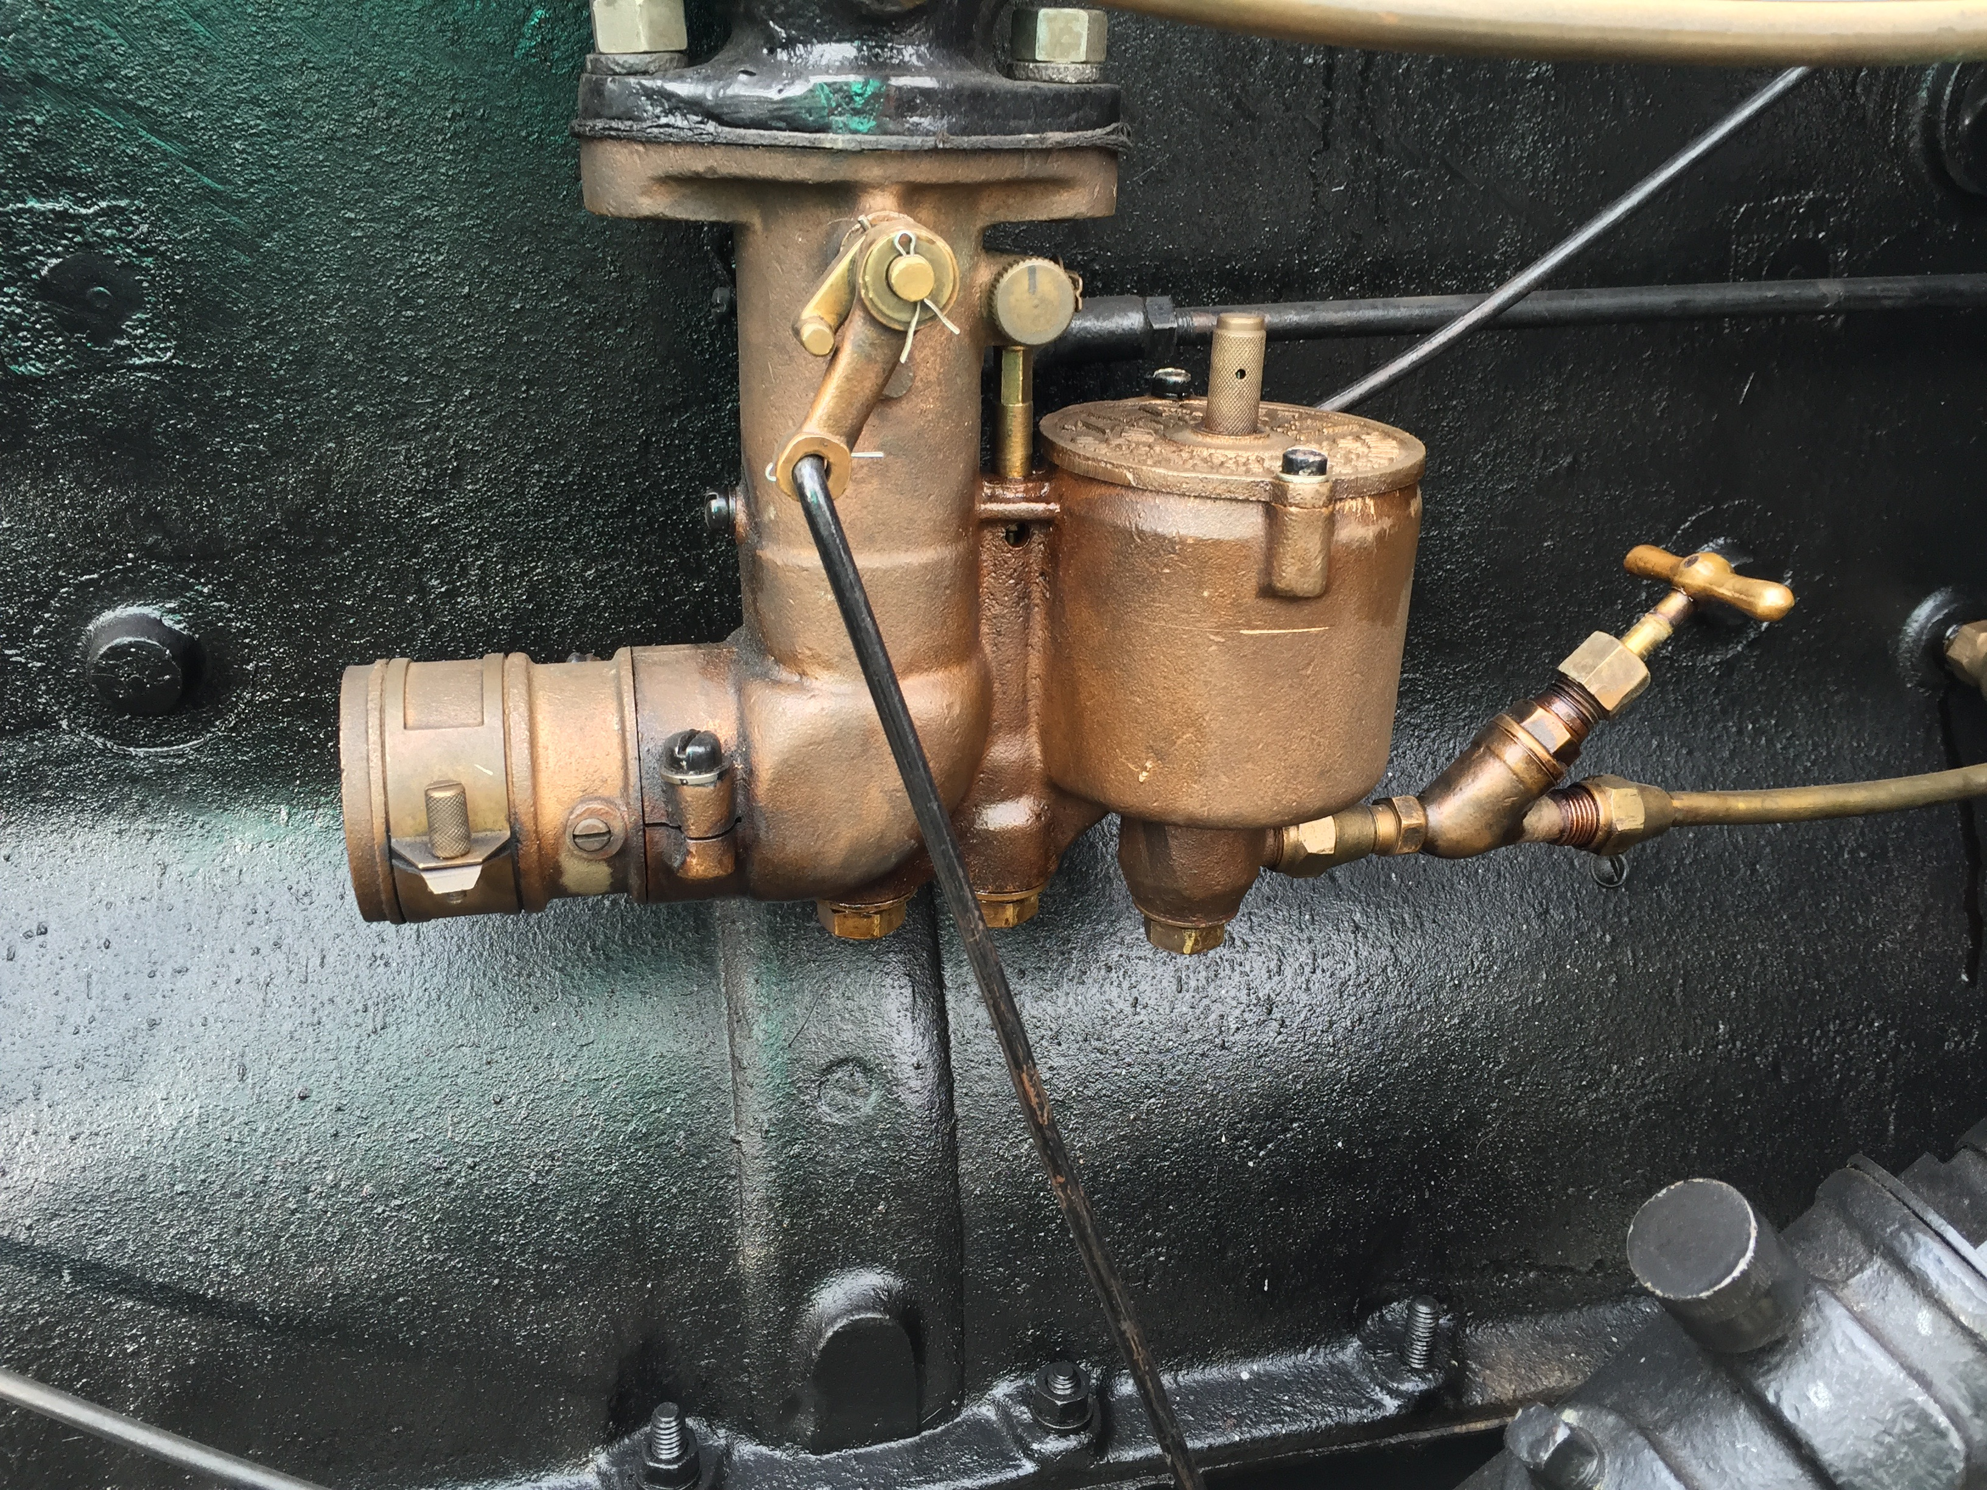
Configurations

Slide 11
Air Flow Control

Slide 12
Fuel Adjustment

Slide 13
High and Low Idle Control

Slide 14
Fuel Reservoir

Slide 15
Diaphragm Carburetors

Slide 16

Compression Ignition Fuel Delivery
Injector Pumps
System Types

Slide 17
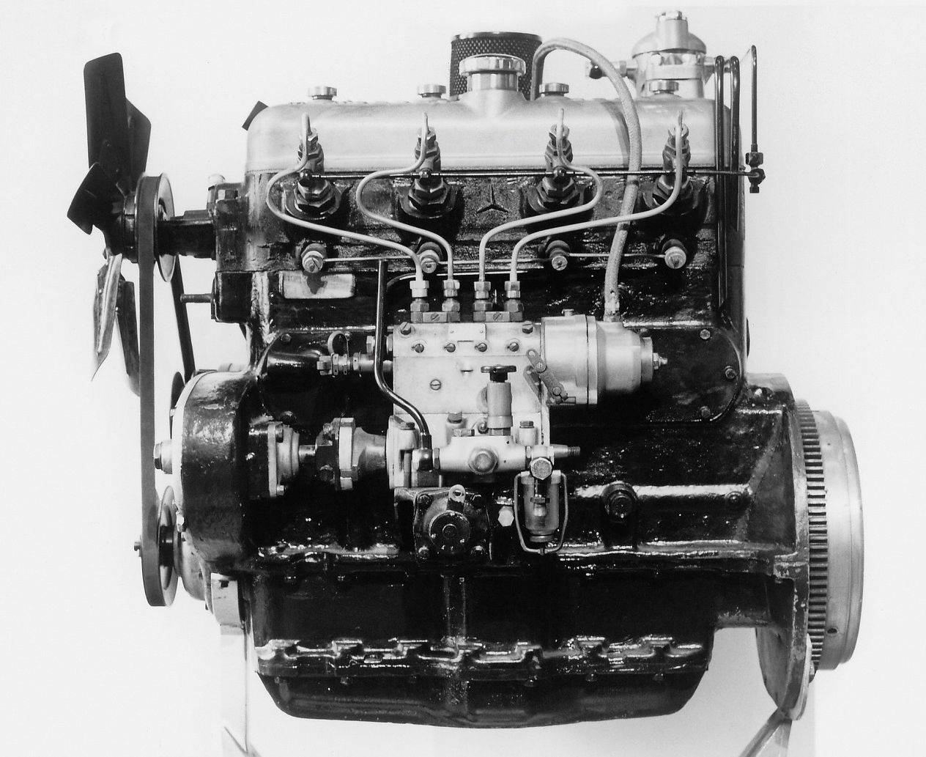
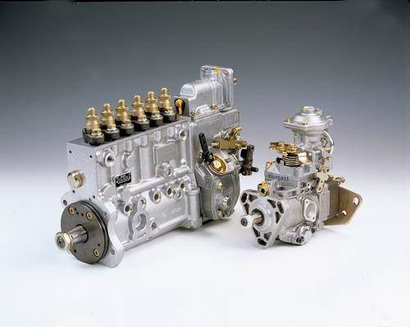

Slide 18
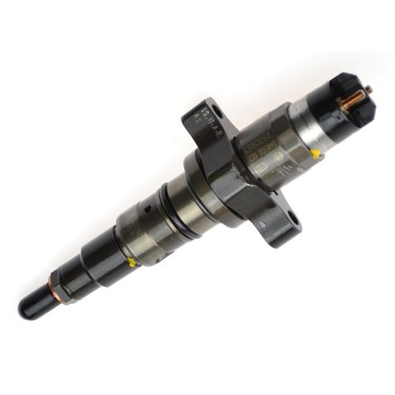
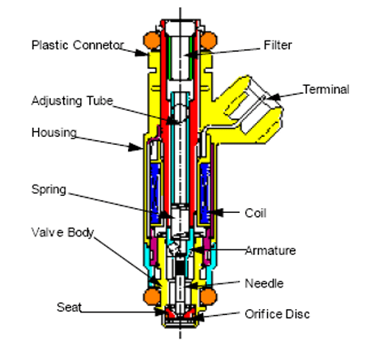

Slide 19
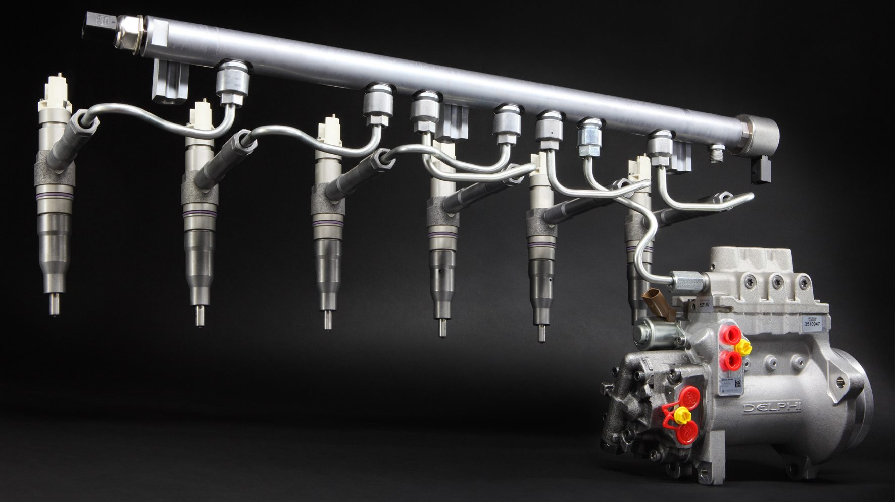
System Types

Slide 20
SI Fuel Injection

Slide 21
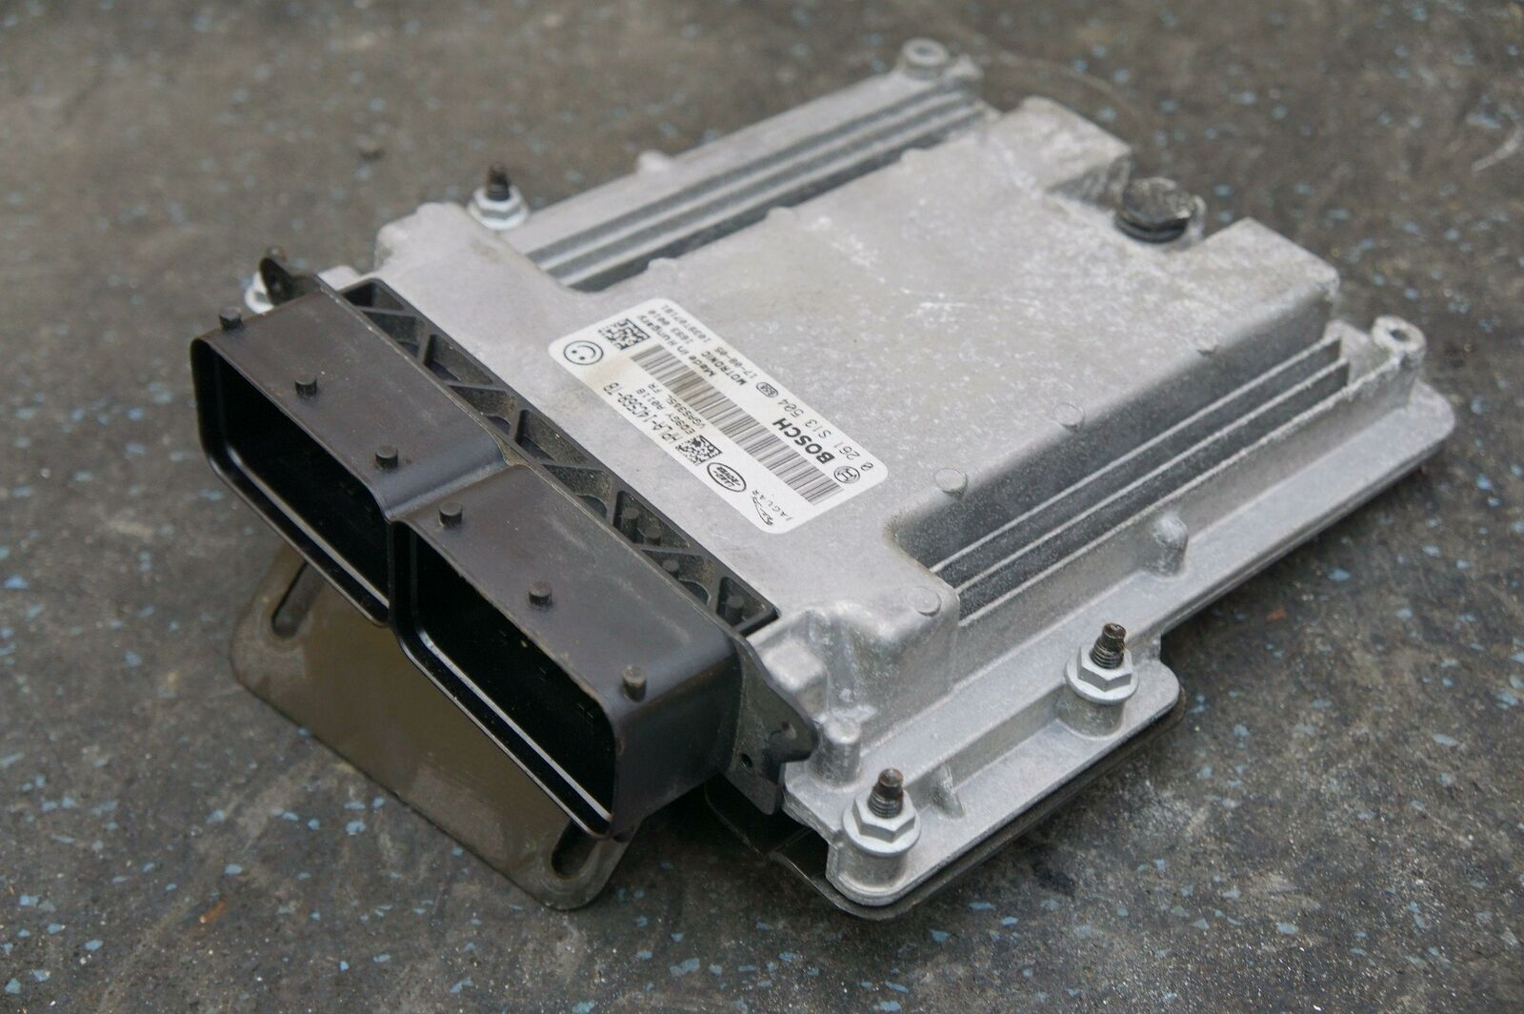
Modern Engine Control

Slide 22
SI Fuel Injection

