Slide 1
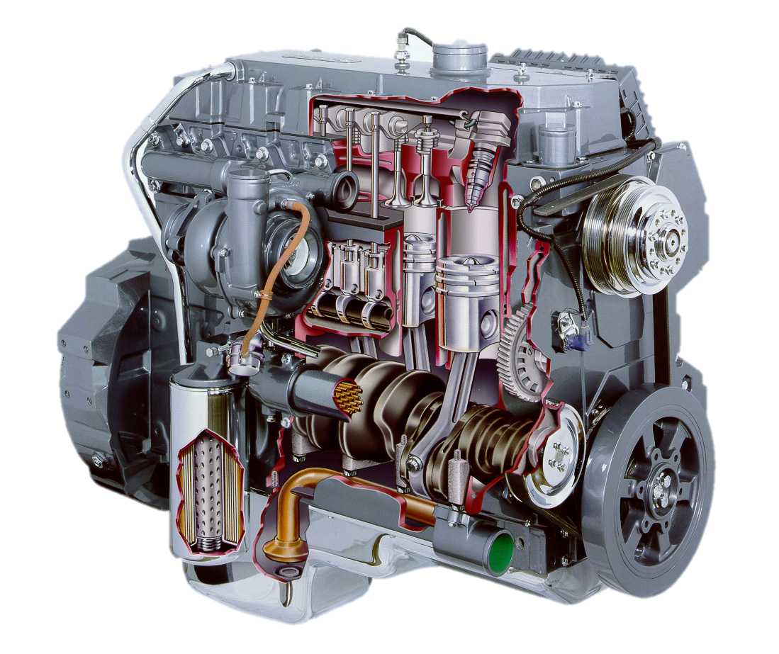
Principles of IC Engines AEN/TSM 220

Slide 2
Fundamentals of IC Engines AEN/TSM 220
Basic Function and Parts
4-Stroke Engines
2-Stroke Engines
Engine Configurations

Slide 3
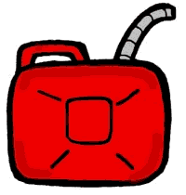
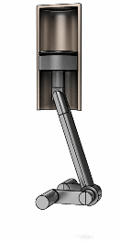
Energy Conversion

Slide 4
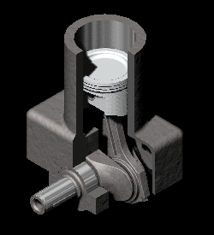
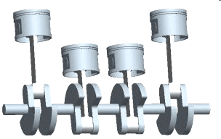
Piston and Crank

Slide 5
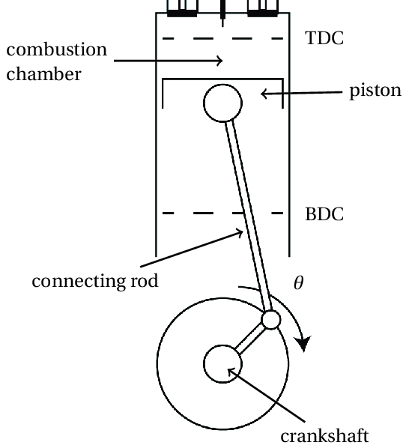
Piston Parts

Slide 6
Engine Classifications
Cycle (Stroke)
4-Stroke
2-Stroke
Rotary
Ignition type
Spark ignition (gasoline, ethanol, LPG, …)
Compression ignition (diesel, biodiesel, …)

Slide 7
Fundamentals of IC Engines AEN/TSM 220
Basic Function and Parts
4-Stroke Engines
2-Stroke Engines
Engine Configurations

Slide 8
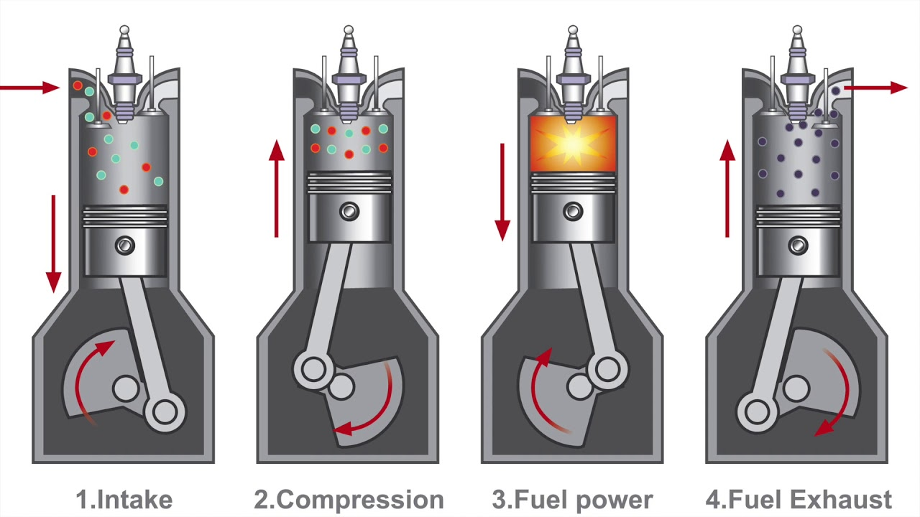
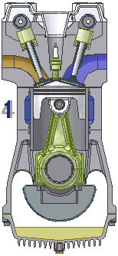
4-Stroke Engine Operation

Slide 9
Fundamentals of IC Engines AEN/TSM 220
Basic Function and Parts
4-Stroke Engines
2-Stroke Engines
Engine Configurations

Slide 10
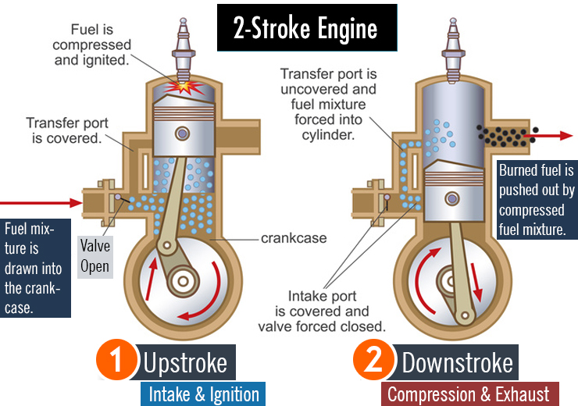
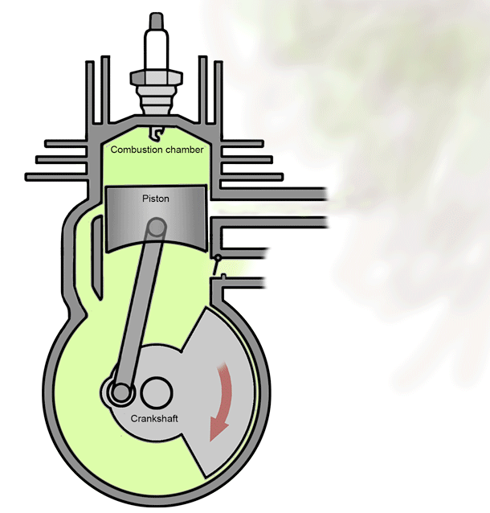
2-Stroke Engine Operation

Slide 11
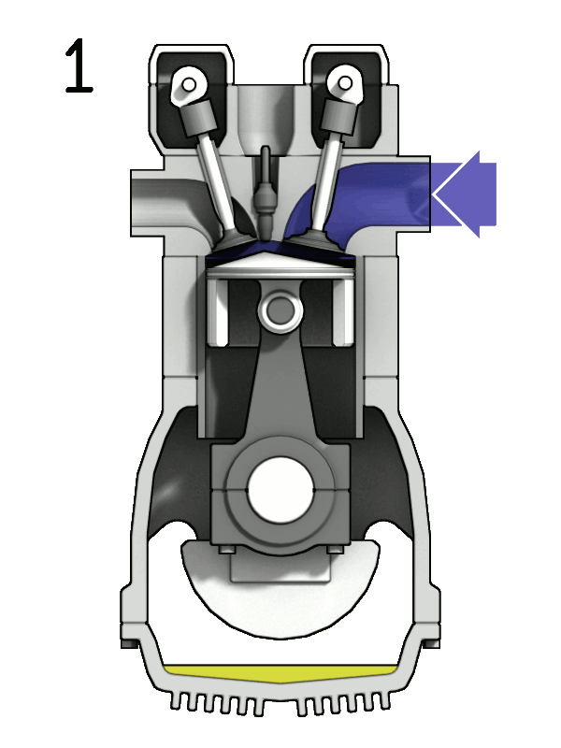
4-Stroke vs. 2-Stroke
2-stroke
1 power cycle per crank revolution
Simpler engine (no valve train)
More power dense
Can be used upside down
Have to mix gas
Dirty
Burning lubricating oil
Carbon build-up (fouled spark plugs)
Incomplete gas exchange

Slide 12
Fundamentals of IC Engines AEN/TSM 220
Basic Function and Parts
4-Stroke Engines
2-Stroke Engines
Engine Configurations

Slide 13
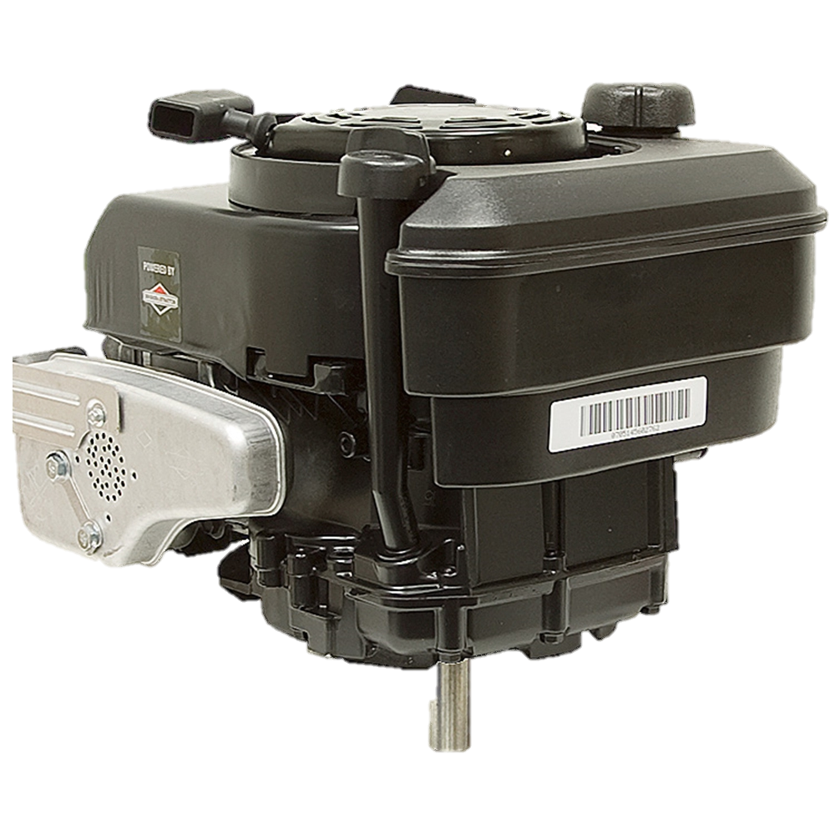
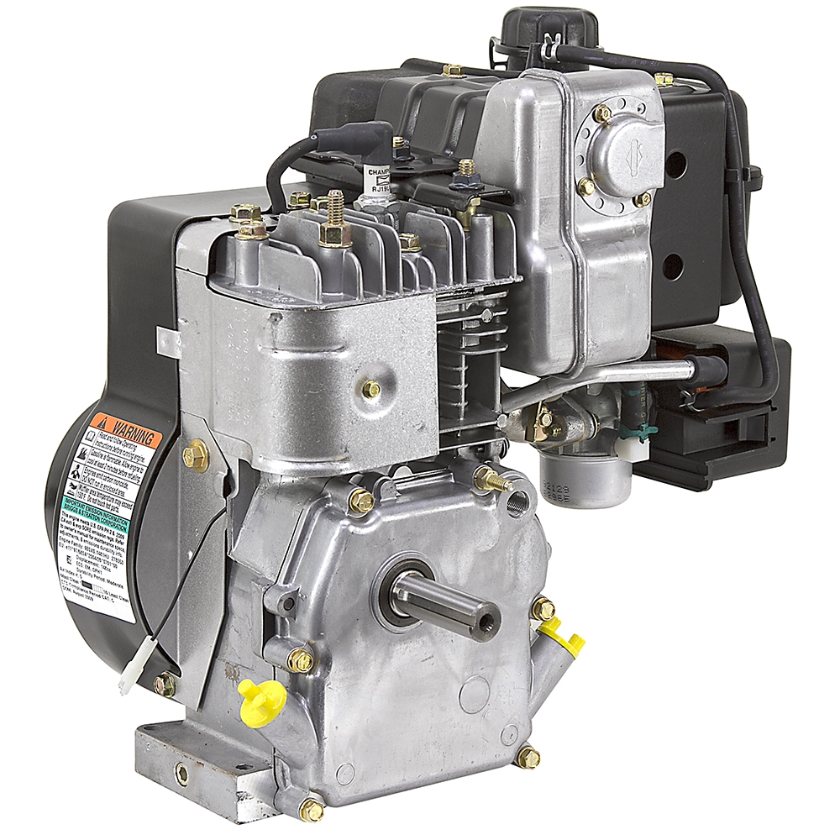
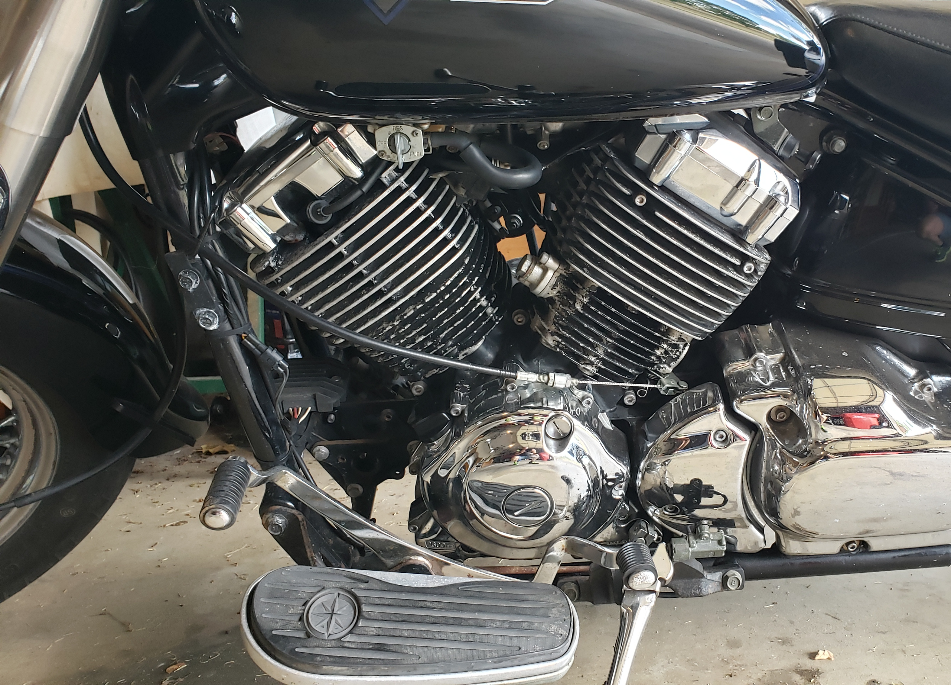
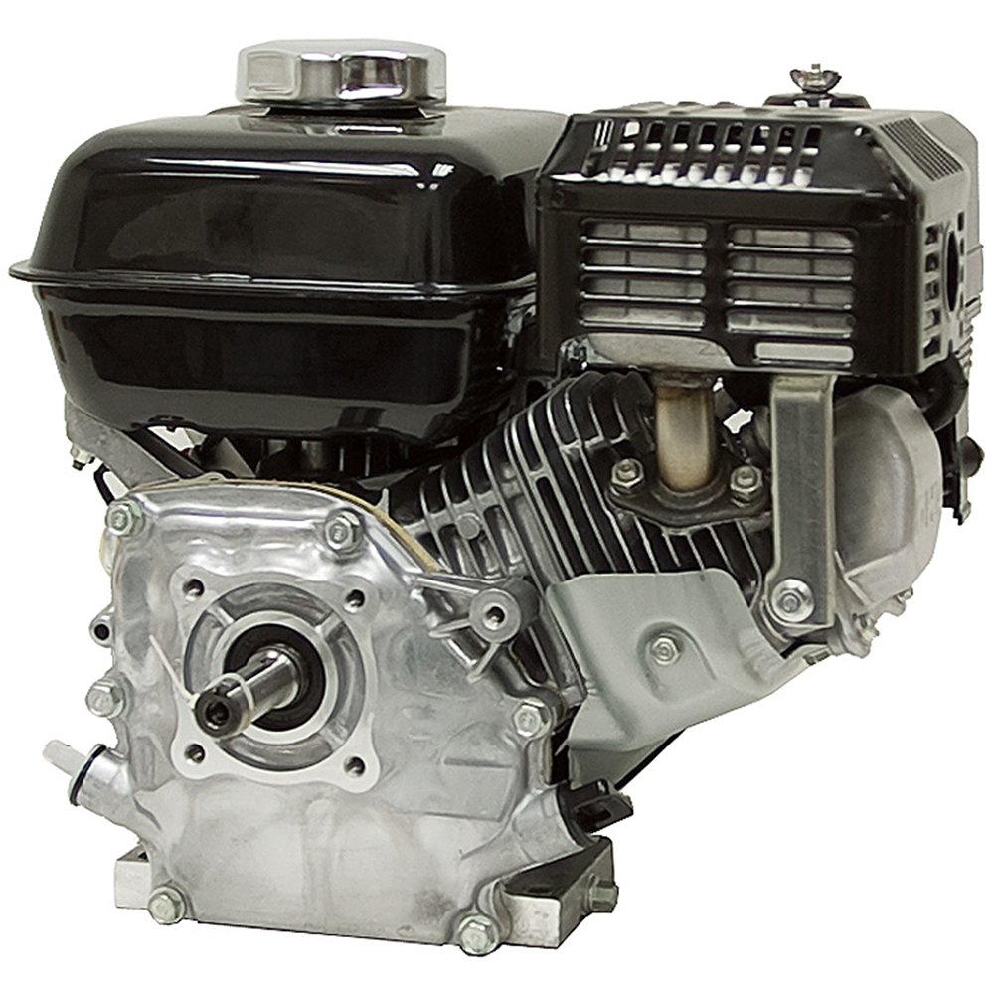
Small Engine Configuration

Slide 14
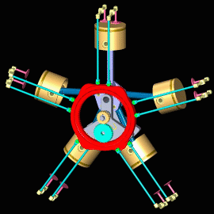
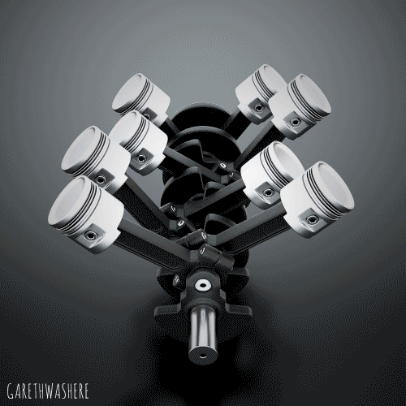
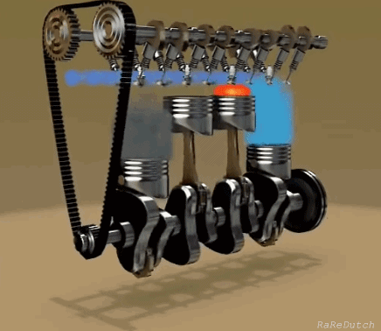
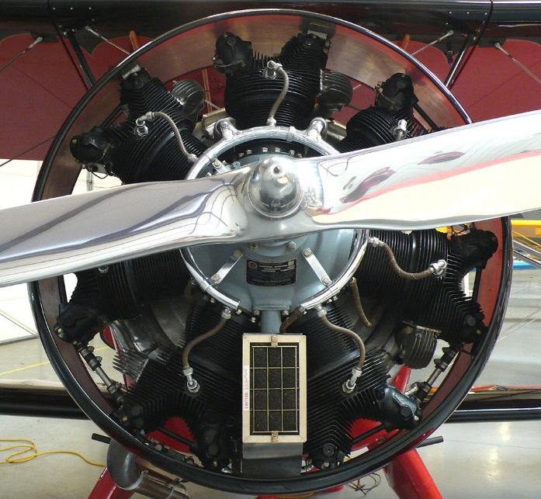
Multi-cylinder Engines

Slide 15
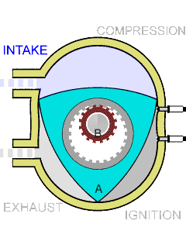
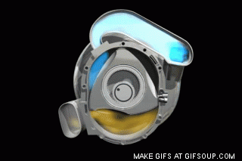
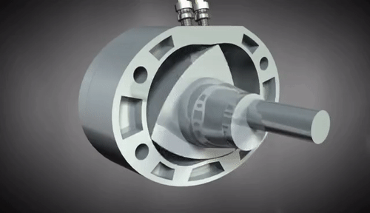
Rotary (Wankel) Engine

