Slide 1
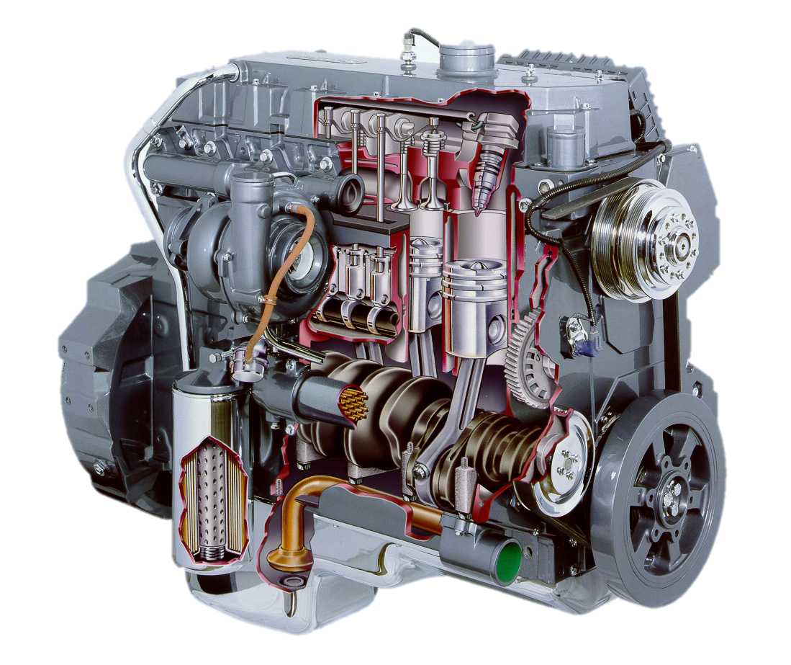
Power Examples AEN/TSM 220

Slide 2
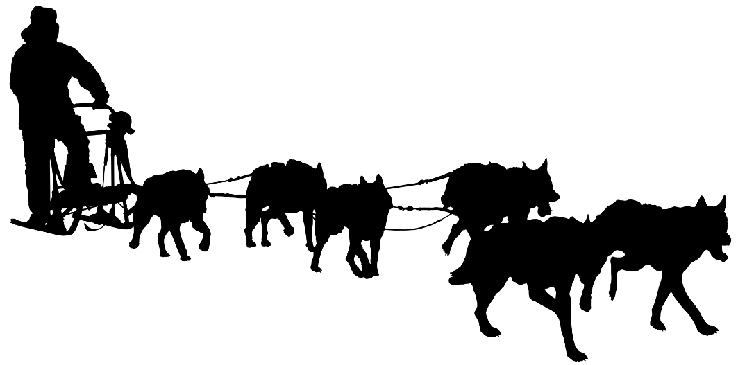
Linear Power
$$Power=\frac{Force ∗Distance}{Time}$$
A dogsled dog can generate about 90N of pull at its harness while maintaining a speed of 16 km/hr. How much power does it generate?

Slide 3
Rotational Power
$$P=T∗n$$
$$P=\frac{T∗n}{5252}$$
A small gas engine was tested on a dynamometer. It generated 174 in-lb of torque at 2900 rpm. How much power did it produce?

Slide 5
The test chassis in our lab is supposed to develop 26 kW of power at a shaft output speed of 540 rpm. How much torque (in N-m) would it be developing at that point?

