Slide 1
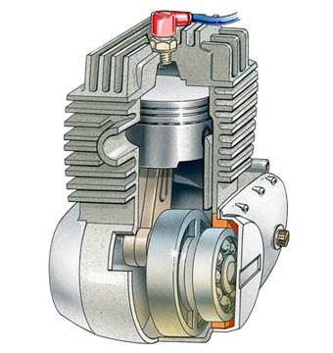
Lubrication
AEN/TSM 220
Why we need it
Lubrication systems
Lubricant Properties
Lubricant Specifications

Slide 2
Functions of Lubricating Oil
Lubricate engine parts
Permit easy starting
Protect against rust and corrosion
Keep engine parts clean
Cool engine parts
Seal combustion pressures
Prevent foaming
Aid fuel economy

Slide 3
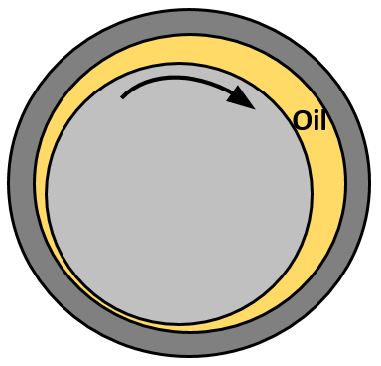
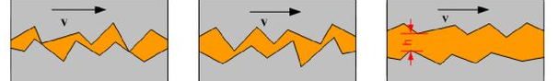
How It Lubricates
Friction
Clearance
Lubricant viscosity

Slide 4
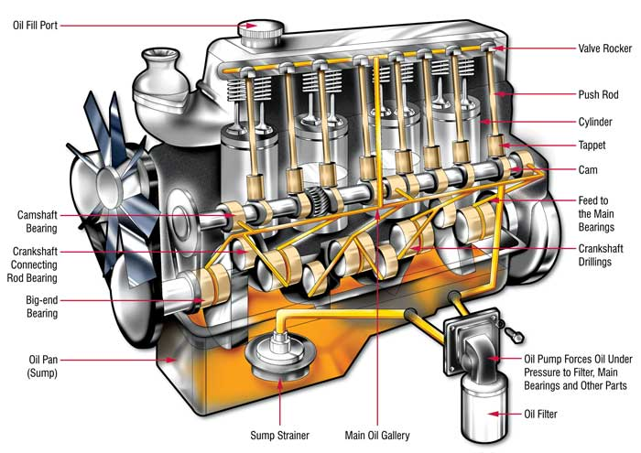
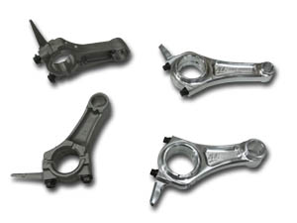
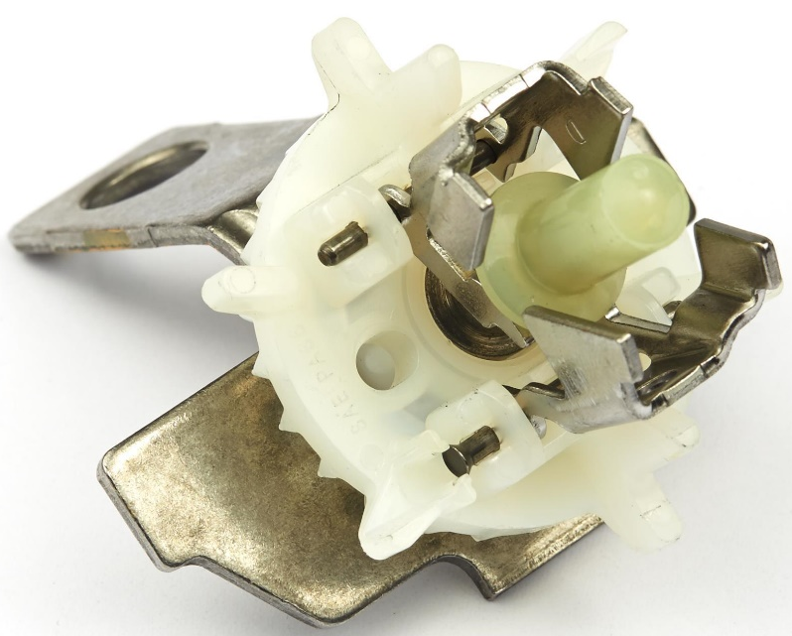
Systems
Splash
Pressure (filter)

Slide 5
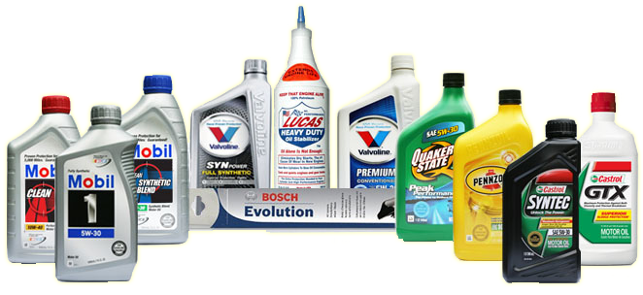
Lubricant Properties
Viscosity
Thermal resistance
Longevity
Foaming
Cleaning

Slide 6
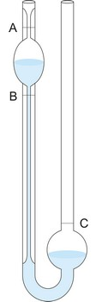
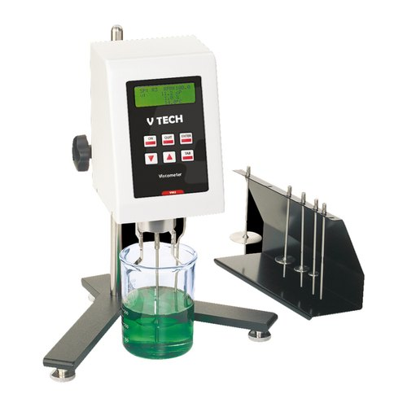
Viscosity
How it is measured
Rating
Multiviscosity

Slide 7
Specifications
Who?
  SAE: Society of Automotive Engineers
  API: American Petroleum Institute
Ratings
  SI: SP, SN, SM, SL, SJ, SH, SG, …
  CI: CK-4, CJ-4, CI-4, …
Certification Marks

Slide 8
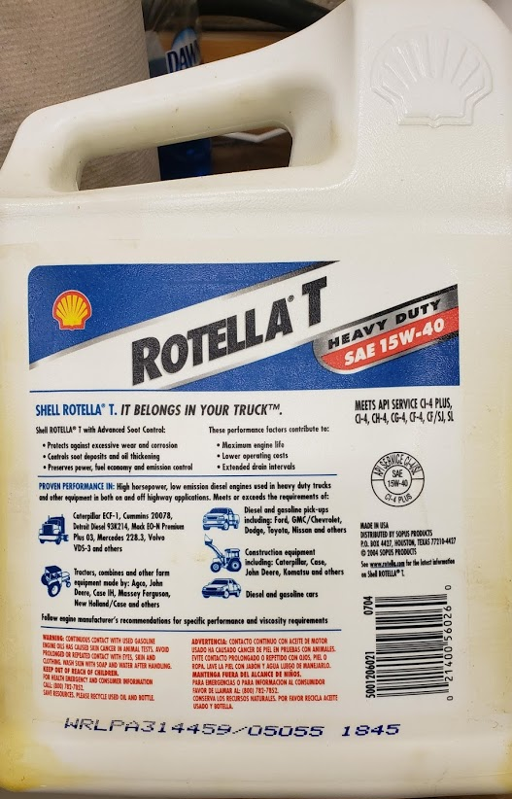
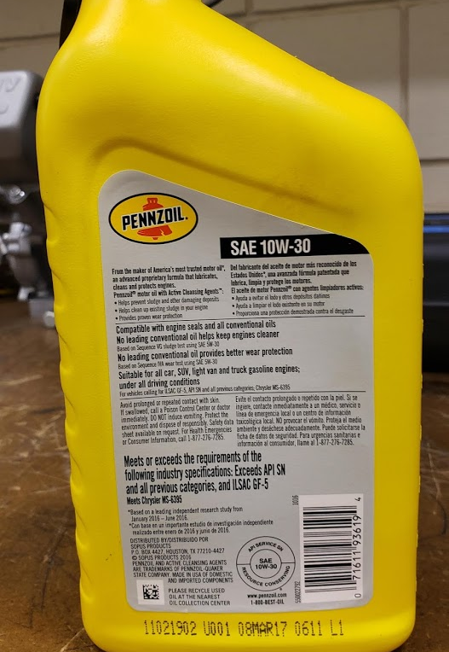

Slide 9
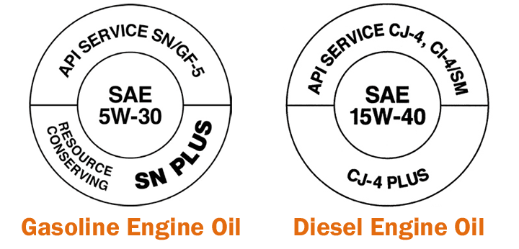
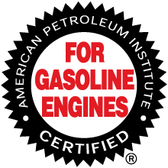
API Certification Marks

Slide 10

Summary
What lubricants do
How lubricants work
Key properties
Specifications and Certifications

