Slide 1
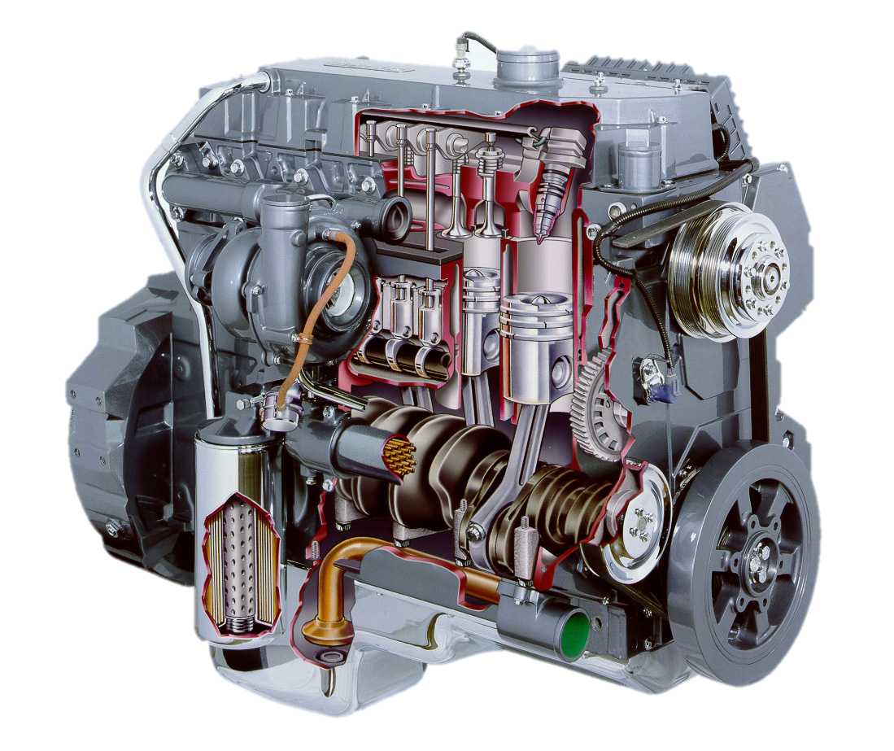
Power Terminology AEN/TSM 220

Slide 2
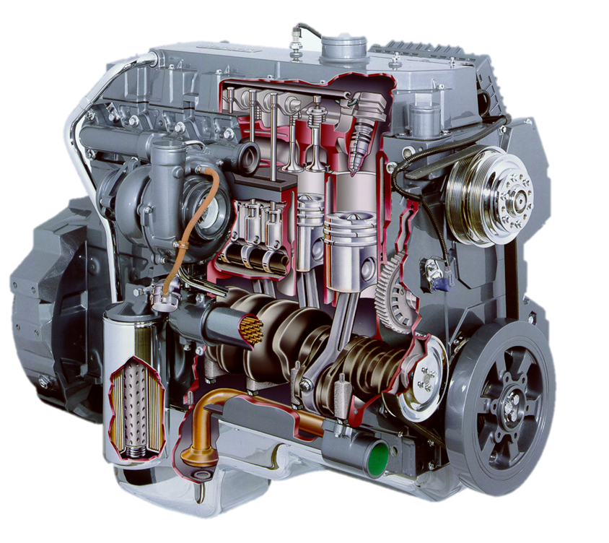
Engine Performance
$$Power=\frac{Force ∗Distance}{Time} = T∗n$$
Force
Torque
Work/Energy
Power

Slide 3
Force
Pushing or pulling of one body on another
Units: lb or N

Slide 4
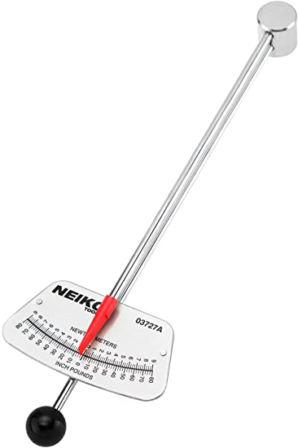
Torque
Ability of a force to cause an object to rotate
Force applied at some distance from center of rotation
Units: lb-ft, lb-in, N-m
$$T=F∗r$$

Slide 5
Work/Energy
Work: force applied through some distance
Units: lb-ft; N-m
Energy: capacity to do work
Units: ft-lb (BTU); N-m = Joule

Slide 6
Power
Rate at which work is being done
Units:
Rotational power:
$$\frac{work}{time} = \frac{force∗distance}{time} = \frac{lb∗ft}{s} \overset{→}{ } hp$$
$$SI: \frac{N∗m}{s} = W$$
$$P=T∗n$$

